Slide 1


We’re excited to see your sample LiveLab! The slides here are from part of a real LiveLab we deliver to our students! Like you’ve talked about, LiveLab is where we marry the classroom with the “real world”. It’s where students get their hands dirty with real-life, real-world data. Each time students log on, they get to tackle a different problem – or problem(s) – that a real organization might be trying to solve. And the best part? You guessed it: they solve these problems with data.
LiveLab is all about practicing thinking like data analysts, asking the right questions, and using tools (python/sql) to find the story that’s hiding in the data. And, maybe even most importantly, also practicing how to communicate that data story.
The following slides are to aid in setting up the company and the problem. The problem (on Slide #6) is about comparing and evaluating the conversion rates of organic acquisitions and paid acquisitions at Headspace. The .csv and the .ipynb (also linked below!) are used to solve the problem and find that story hidden in the data.
You’ll use them – with your own flare – to deliver it for your Sample Teach Interview. We’re looking for a rockstar teacher who will incorporate their passion for data analytics and their “real-world” experiences into the learning topic we teach.
You’ll find some speaker notes in each slide, but we ask you to put your own spin on delivering this lesson to students. Make sure you’re keeping your “students” engaged. Invite us to come off mute, encourage participation in the chat, lean on techniques you know and use. If you’re so inclined, feel free to make a copy of these slides and edit them to be your own. We can’t wait to see what you come up with!
p.s. You might find it more effective to use a Jupyter Notebook and make use of markdown. We’re perfectly okay with that, too!
p.p.s. Here is a direct-to-download link of a corresponding .ipynb file and here of the dataset.

Slide 2




CLIENT INTRODUCTION
Headspace
Notes:
Note to candidate: Remember, remember! LiveLab is where students get to play the part of working in their very own data analytics consulting group. They get to act as and think as data analysts who are there to develop data-driven solutions to business problems for our clients, just as they would if they were actually employed as analysts! Sound fun? It is.
This LiveLab explores the intersection of mental well-being and data analysis.
“Let me to introduce you to a digital platform that has been transforming the way millions of people approach their mental health: Headspace.”

Slide 3
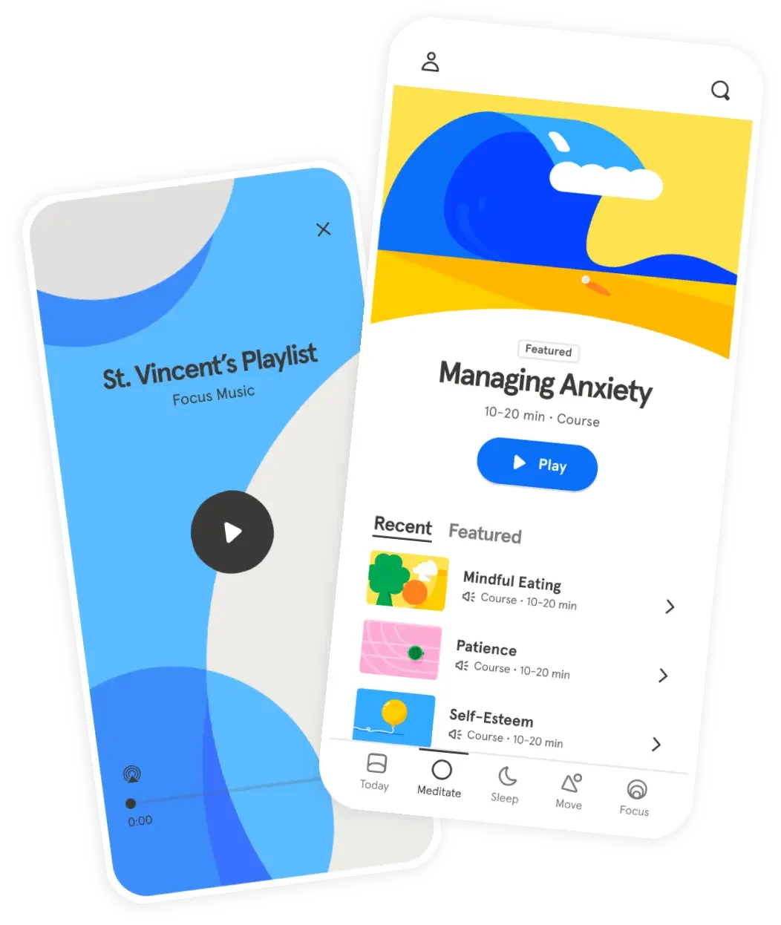
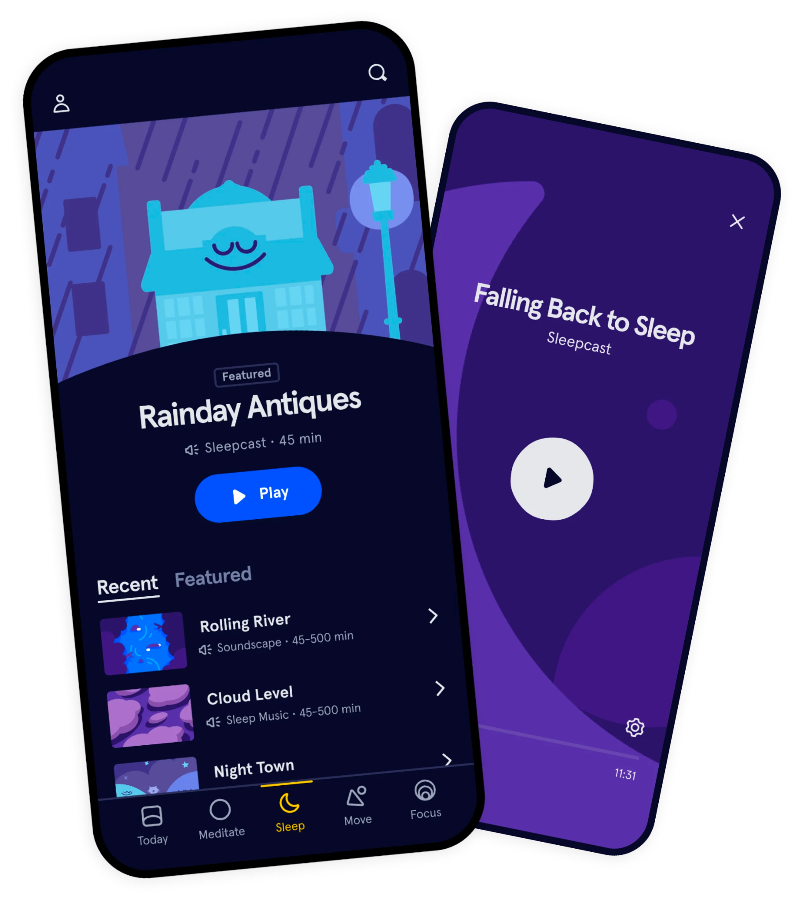
Notes:
Headspace is a popular meditation and mindfulness app, provides guided meditation sessions, sleep exercises, and other mindfulness techniques
Its mission is to make mindfulness available to everyone, everywhere, and play a role in improving the world's mental wellbeing.
Guided meditations
Sleepcasts
Focused music playlists
Content designed to address specific areas such as stress, sleep, anxiety, focus, and relationships
Headspace is super popular because of its user-friendly interface, it’s high-quality content, effective approach to meditation …
Offers a combination of free and premium content. Premium content requires a paid subscription

Slide 4


Let’s talk about
acquisition
Notes:
“Before we dive what the Headspace team needs from us, let’s take a moment to talk only for a second about what marketing teams call organic and paid acquisition.”

Slide 5
Organic Vs Paid Acquisition
Organic Acquisition:
Acquire new customers without paying any direct fees
Paid Acquisition:
Acquire new customers by paying to acquire them
Notes:
Organic acquisition:
generates traffic to your business overtime for free
Goal: (typically) to build brand awareness.
Internet search/SEO
Blogging
Social media
Emails
Referrals
Influencer marketing
Longer term play
Paid acquisition:
generates traffic to your business quickly through paid ads.
Goal: (typically) to convert audience into sales or leads.
social media ads
Google ads
TV commercials
Print ads
Billboards
Note to candidate: This is a great spot to engage your students!

Slide 6
Problem Statement
In an effort to determine which acquisition group is more likely to become paid Headspace subscribers, the marketing team has requested that we compare and evaluate the conversion rates of organic acquisitions and paid acquisitions.
Notes:
Present goal of LiveLab to students: the Headspace marketing team is super interested in gaining insights on the conversion rates of organic acquisitions compared to paid acquisitions in terms of becoming paid subscribers.
They believe a better understanding of this will provide valuable insights for future marketing strategies.
Note to candidate: Transition here to the .ipynb file, walk through the remainder of the LiveLab! We’ve given you a file with solutions in it, but in your sample teach, those solutions should not be there. You’ll arrive at the solutions with your students. Keep this scenario top of mind. Students always like to know why they are doing something. And remember: LiveLab is not where students are learning content for the first time, it’s where they’re applying what they’re learning in parallel.

Slide 7
So….How Do We Calculate
Conversion Rates?
Organic Acquisition
COUNT(paid)
COUNT(paid)+COUNT(free)
Paid Acquisition
COUNT(paid)
COUNT(paid)+COUNT(free)
Notes:
Organic acquisition:
generates traffic to your business overtime for free
Goal: (typically) to build brand awareness.
Internet search/SEO
Blogging
Social media
Emails
Referrals
Influencer marketing
Longer term play
Paid acquisition:
generates traffic to your business quickly through paid ads.
Goal: (typically) to convert audience into sales or leads.
social media ads
Google ads
TV commercials
Print ads
Billboards
Note to candidate: This is a great spot to engage your students!

Slide 8
PseudoCode
The marketing team wants to compare and evaluate the conversion rates of organic acquisitions and paid acquisitions to determine which group is more likely to become paid Headspace subscribers.
Notes:
Present goal of LiveLab to students: the Headspace marketing team is super interested in gaining insights on the conversion rates of organic acquisitions compared to paid acquisitions in terms of becoming paid subscribers.
They believe a better understanding of this will provide valuable insights for future marketing strategies.
Note to candidate: Transition here to the .ipynb file, walk through the remainder of the LiveLab! We’ve given you a file with solutions in it, but in your sample teach, those solutions should not be there. You’ll arrive at the solutions with your students. Keep this scenario top of mind. Students always like to know why they are doing something. And remember: LiveLab is not where students are learning content for the first time, it’s where they’re applying what they’re learning in parallel.

